Slide 1
HOSPITAL MANAGEMENT SYSTEM
GROUP MEMBERS
AKSHAY CHANDRA - 2510080055
LAKSHITH - 2510030332
CHETAN CHOUDARY - 2510030334

Slide 2
PROJECT OVERVIEW
The Hospital Management System is an application designed to manage hospital operations efficiently.
It helps in handling patients, doctors, appointments, and medical records in an organized way.
The system reduces manual work and improves accuracy and speed of operations.
Key Objectives:
Digitize hospital data management
Reduce paperwork
Improve patient handling and tracking

Slide 3
FEATURES OF THE SYSTEM
Doctor Information Display View list of doctors from stored records
Patient Management Display patient details like ID, name, and disease
Search Patient Search patient using unique ID
Appointment Slots Predefined time slots for scheduling visits
Medicines Information Display available medicines from file
Sorting of Patient IDs Arrange patient records in ascending order

Slide 4
CONCEPTS USED IN THE PROJECT
Java Programming
File Handling (for doctors & medicines)
Data Structures:
Arrays
Linked List
Stack
Queue

Slide 5
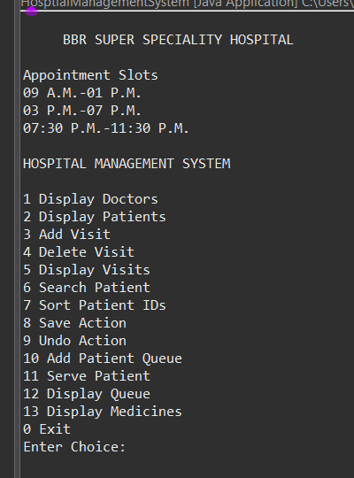
OPERATIONS OF OUR SYSTEM

Slide 6
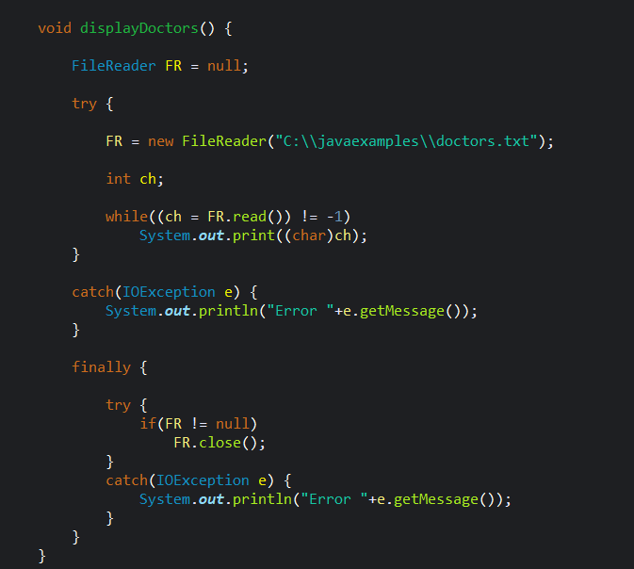
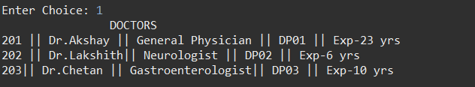
DISPLAY DOCTORS
JAVA CODE OUTPUT
rr

Slide 7
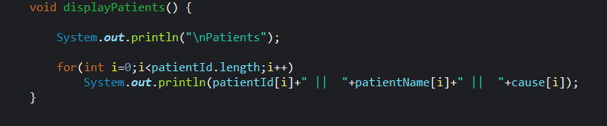
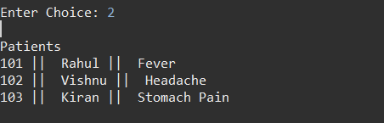
DISPLAY PATIENTS
JAVA CODE
OUTPUT

Slide 8
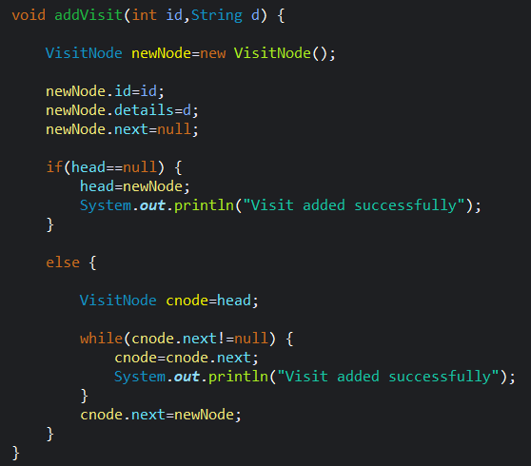

ADD PATIENT VISIT
JAVA CODE OUTPUT

Slide 9
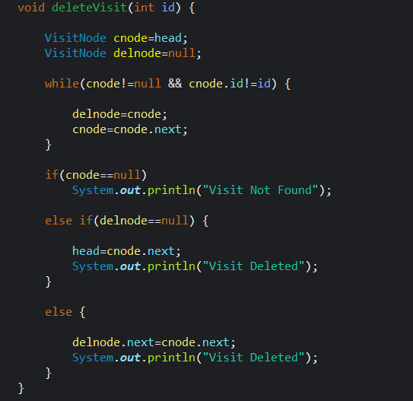

DELETE PATIENT VISIT
JAVA CODE OUTPUT

Slide 10
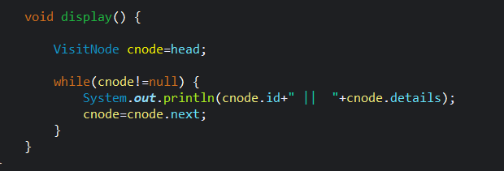

DISPLAY PATIENT VISIT
JAVA CODE
OUTPUT

Slide 11
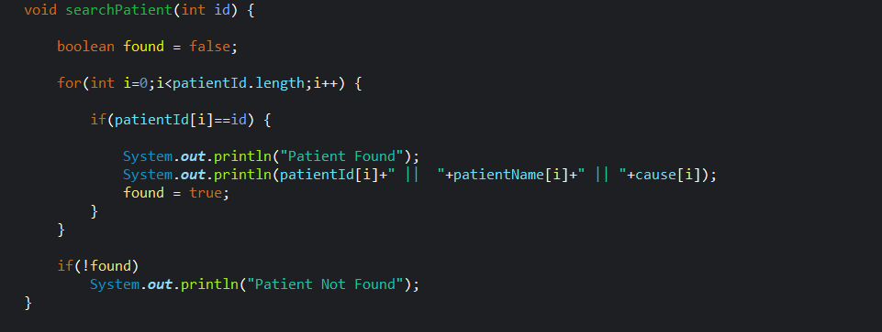

SEARCH PATIENTS
JAVA CODE
OUTPUT

Slide 12
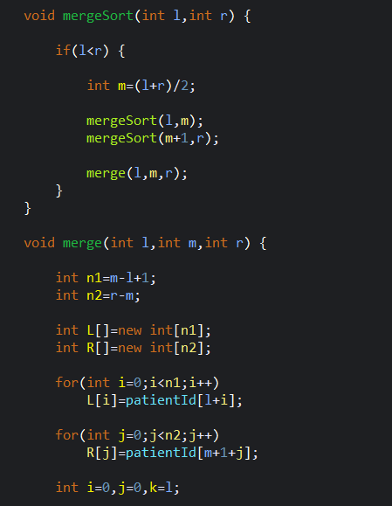
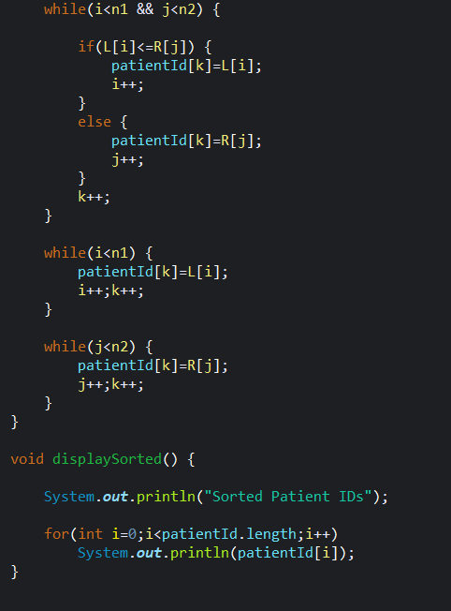

SORT PATIENTS BY ID
JAVA CODE OUTPUT

Slide 13
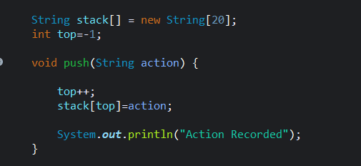

SAVE ACTIONS TO BE DONE
JAVA CODE OUTPUT

Slide 14
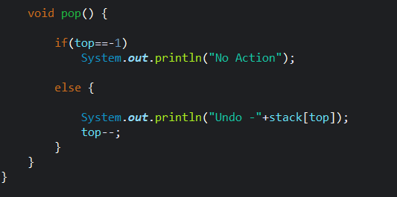

UNDO THE ACTIONS
JAVA CODE OUTPUT

Slide 15
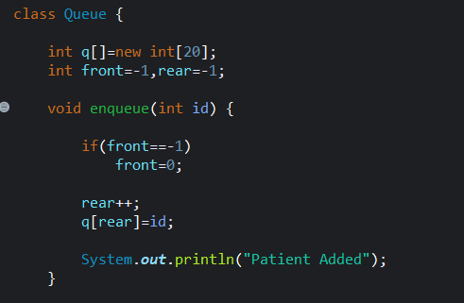

ADD PATIENT
JAVA CODE OUTPUT

Slide 16
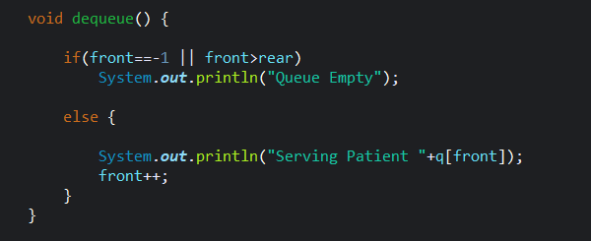

SERVE PATIENT FROM THE QUEUE
JAVA CODE OUTPUT

Slide 17
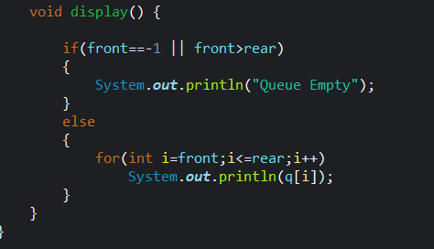

DISPLAY PATIENT QUEUE
JAVA CODE OUTPUT

Slide 18
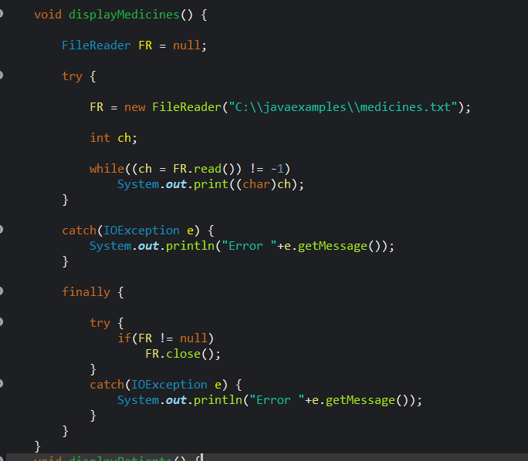
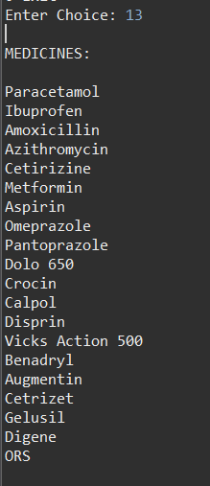
DISPLAY MEDICINES
JAVA CODE OUTPUT

Slide 19
CONCLUSION
Implemented multiple data structures:
Arrays
Linked List
Stack
Queue
Demonstrates real-world hospital system
THANK YOU

